Slide 1

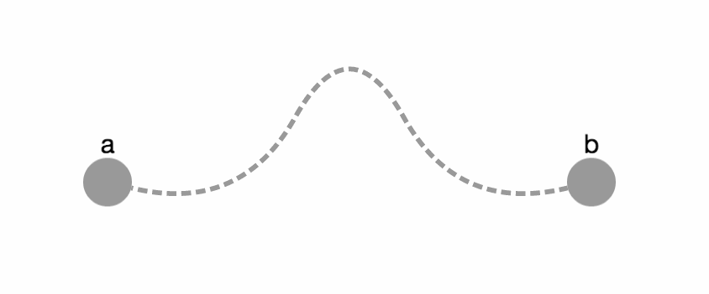
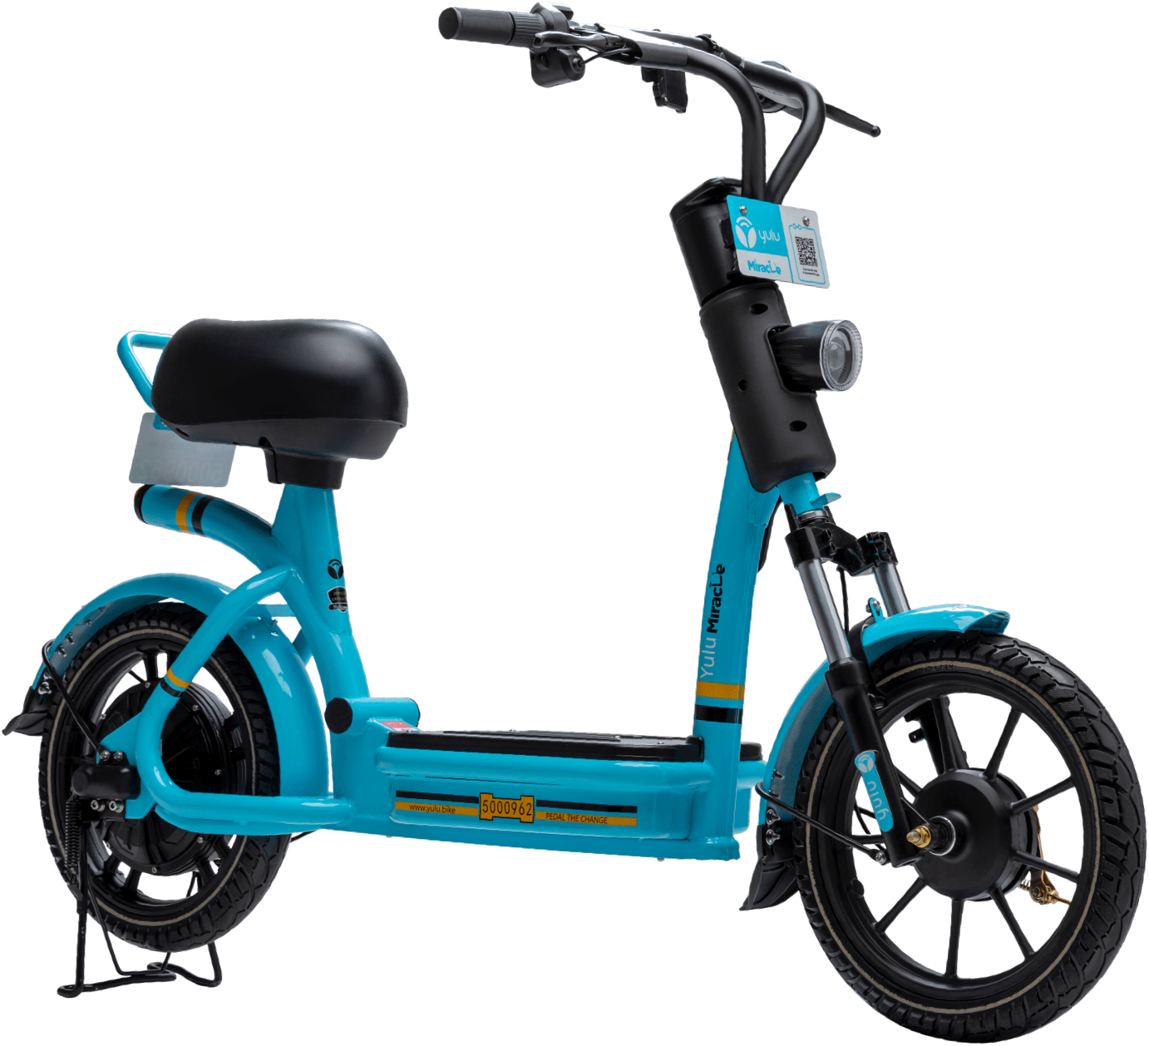
Moving India towards a
sustainable future.
A CASE STUDY.

Slide 2
01
02
TARGET AUDIENCE
03
04
MARKETING STRATEGIES
MEASURING SUCCESS
PRELIMINARY RESEARCH
About the startup, its competitors and the micro-mobility market.
Analysis of Target Audience and Defining User Personas
Defining unique marketing strategies with emphasis on feasibility and cost.
Analyzing KPIs for the marketing strategies with the present day reference.

Slide 3
WHAT IS YULU?
Yulu is an Indian technology-driven mobility platform that enables Integrated Urban Mobility across public and private modes of transport.
The company aims to promote electric mobility, primarily in urban areas and help sustain a healthier and greener future for the planet and our community.

Slide 4
Yulu is taking it upon themselves
to do what’s in their hands and help India move towards
the achievement of the UN’s 2030 Agenda for
Sustainable Development.
Yulu offers it’s services through two products-

Slide 5
YULU MIRACLE
Clever Mechanical Design
Smart Vehicle
Lightweight
Greater Stability
Powered by state-of-the-art IOT Technology with features such as battery indicators
Adaptability
Comfortable for all
Designed for urban traffic conditions with a maximum speed of 25 Km/h with efficient handling manoeuvrability
Unisex ultra-comfortable bike for any height and weight.
Extra legroom

Slide 6
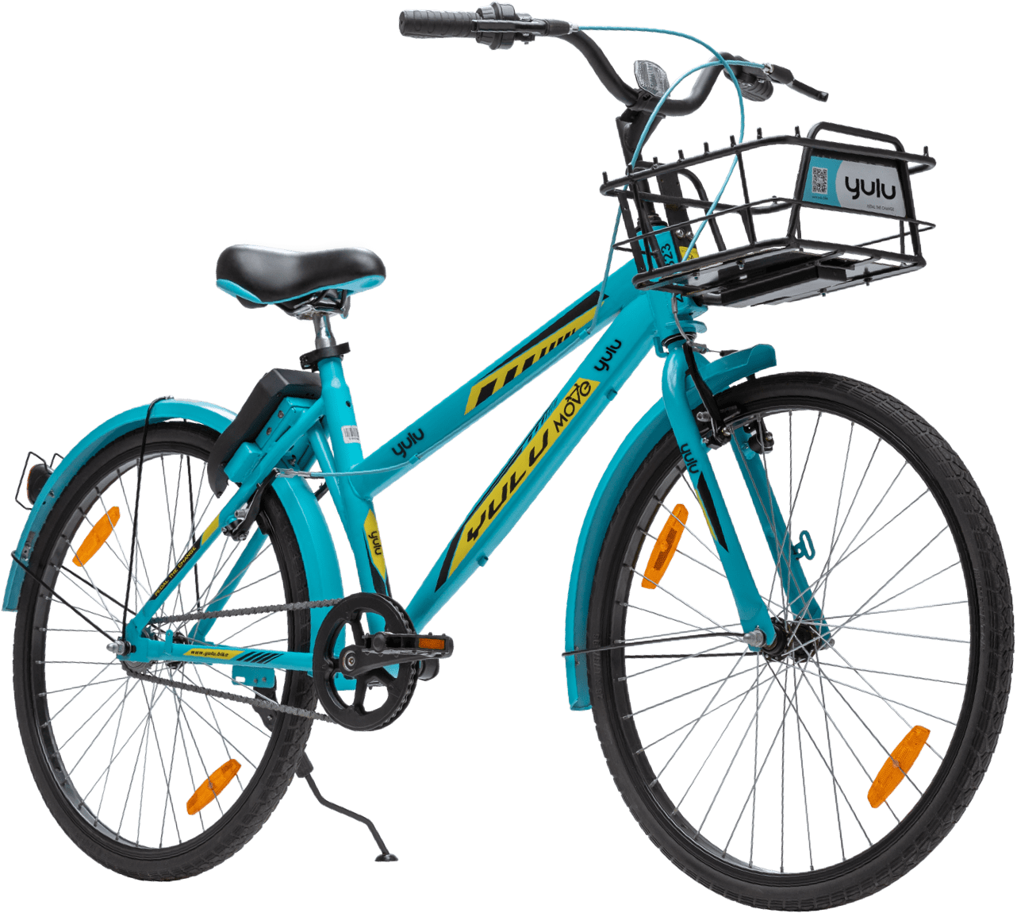
YULU MOVE
Smart lock enabled bicycle
Robust Body with a unisex frame and adjustable seat height for better consumer experience.
Solar Powered Smart Lock fitted with GPS, GPRS and Bluetooth technologies.
Effectively solves short distance commute challenges.

Slide 7
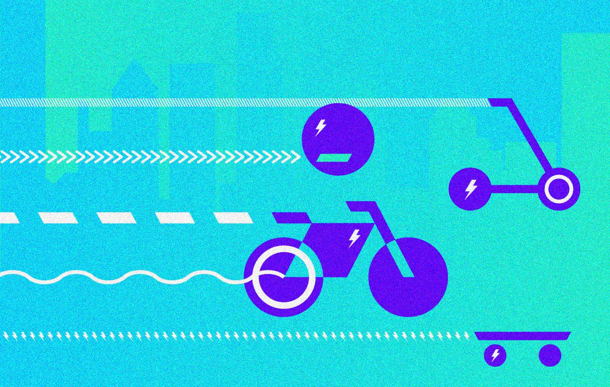
The Micromobility industry
AN ASSESSMENT OF THE PARENT MARKET

Slide 8
MICRO
MOBILITY
Reduces the number of cars on the road
Lowers our environmental footprint
Provides convenient methods of transportation
Increases access to public transportation
What is micromobility?
Micromobility refers to short-distance transport, usually less than 5 miles.
Increasingly, it is shorthand for the growing crop of the bike– and scooter-sharing companies that are poised to remake the urban landscape, like Yulu.
Urbanization
Micromobility

Slide 9
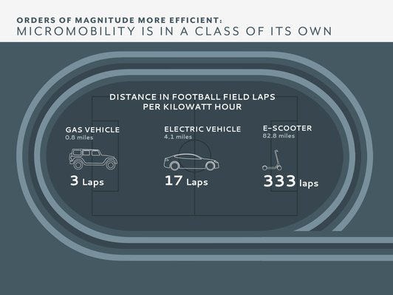




60%
<8km
of car trips across the world are
65%
of people projected to live in cities by 2040
This means more growth opportunities for the micromobility market!
Ridesharing is a major application of the micro mobility industry but results in the loss of privacy of the passengers travelling and hence a large number of customers do not prefer ride-sharing.
Yulu comes into play once more with its strategic planning and implementation of single ride e-bikes.
Yulu exploited this information to its full advantage!

Slide 10
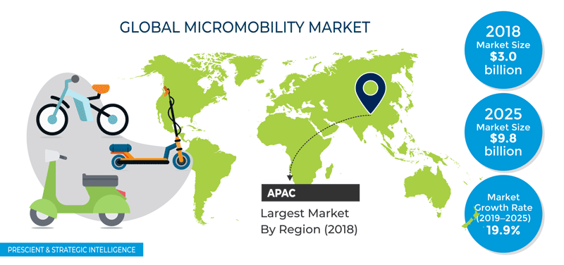
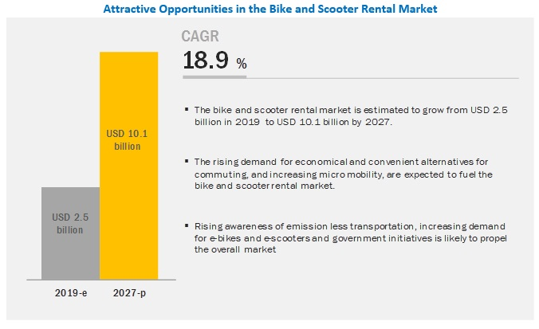


Due to these promising numbers,
Yulu inked a partnership with Uber in 2019, allowing users to access its bikes through the Uber app.
In November 2019, motorcycle manufacturer Bajaj Auto backed Yulu in its $8M Series A round and entered a strategic partnership with the startup to design and produce its E-Scooters.

Slide 11



MAIN COMPETITORS
ELECTRIC?
REVENUE
$1.5M
$1.2M
$4M
$9.7M
$3M
FUNDING
$18.9M
$157M
$692K
$148.4M
$361.7M
EMPLOYEES
200
400
150
500
70

Slide 12
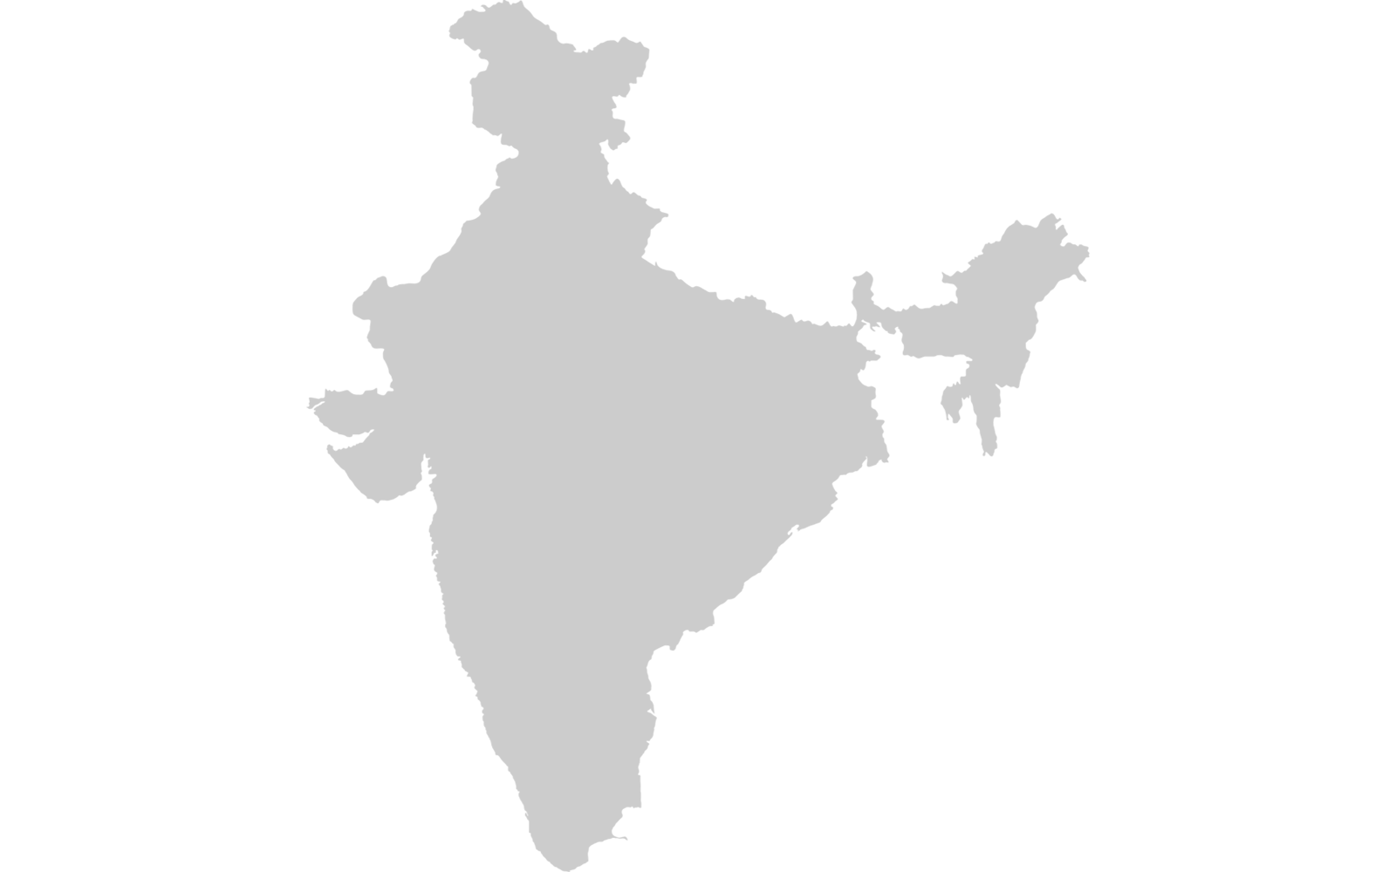
AREAS OF OPERATION
Delhi NCR
Yulu is a startup based in Bangalore and is thus well established in the city.
Currently, Yulu operates in 5 cities all over the country.
Bhubaneswar
Mumbai
Pune
Bangalore

Slide 13
CHALLENGES TO MICRO-MOBILITY
CITY INFRASTRUCTURE
REGULATION
HARDWARE HEALTH
If a city lacks the proper infrastructure such as sufficient bike lanes, adoption of shared bicycles and scooters becomes difficult and even dangerous to the public.
As dockless bikes and scooters remain a relatively novel concept, most cities do not have proper regulations in place for how these programs are allowed to run.
As bikes break, companies often don’t have the manpower in place to fix them in a timely manner, resulting in frustrated users having to test several bikes before finding one that works properly.

Slide 14


TARGET AUDIENCE
Demographics
Geographics
Urban Areas of India
Metropolitan Cities, For e.g. ,
Psychographics
Intention: - To solve first and last mile commute problems. - To avoid traffic and vehicle congestion.
Age: 16-40 yrs.
Employment: 1) IT professionals 2) College students 3) Business consultants
Interests: Actively encourages envt-friendly activity.
Mumbai, Delhi, Pune, Bangalore, Hyderabad etc.
Income: Low to Middle Class

Slide 15
GUESSTIMATE:
To predict the number of customers that can use Yulu
With a mission to reduce vehicle congestion on roads and help solve first and last-mile commute problems, Yulu is seen to be adored mainly by IT professionals and college students, in all major cities of India.
Therefore, this guesstimate is taking into account all major IT and education hubs of the country, namely Bangalore, Mumbai, Delhi, Pune, Chennai and Hyderabad.
Some assumptions include:
The average population of a metropolitan city has been taken to be ~ 10 million.
Given these are all major IT hubs, 30% of their population is assumed to be working in this sector.
The age demographic considered is such that around 60% of the population is in the age group of 16-40yrs, i.e. students and young working professionals.
Within an IT firm, 75% of employees receive low income to medium income.
Since a lot of students come from across the country to these cities, 10% of their population is assumed to be consisting of students.

Slide 16
# in IT sector
=30%*(10m) =3m
# in low-middle income
=75%*(1.8m) = 1.35m
# in Age: 16-40
= 60%*(3m) =1.8m
# using Yulu over other options
=80%*(1.35m)
= 1.08m
# in IT in all 6 cities
=1.08m*6
= 6.48m
# of college students in all
= 0.8m*6
= 4.8m
# of Consumers who can use Yulu
11.28m
Total Population
= 10 million
% of college students
= 10%
# of college students
= 10%*(10m) = 1m
# using Yulu over other options
= 80%*(1m) = 0.8m

Slide 17
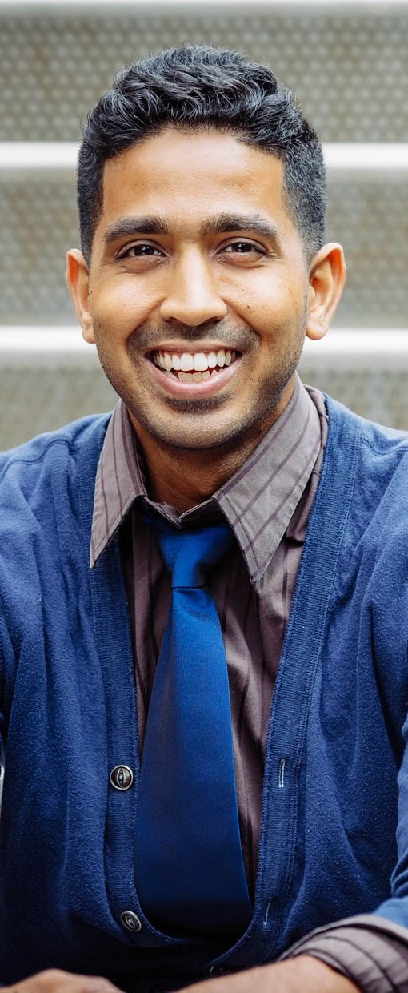






OVERVIEW
GOALS
Working a 9 to 5 at ORACLE since 2 years.
Lives in a rented apartment.
Getting promoted to a higher paying post.
Buying an apartment.
Wants a hassle free solution for his daily commute.
INTERESTS
Gardening
Travelling
Peer mentoring
Likes to engage in
political conversations
on Twitter.
INTEREST IN JOB
PAIN POINTS
Daily commute is a time
consuming and an
expensive affair.
Traffic congestion affects his mental well being.
Managing yearly budget.
HRIDAY AHUJA
27, Bangalore
AFFORDABILITY
SOFTWARE ENGINEER AT ORACLE
FAVOURITE SOCIAL MEDIA SITES
^{· STATUS}
^{SINGLE}
^{· SALARY}
^{8LPA}
TIME AVAILABILITY
^{· ARCHETYPE}
^{PERFECTIONIST}

Slide 18
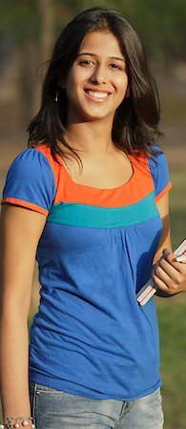

OVERVIEW
GOALS
A well informed Electrical Engineering Undergrad at IIT Bombay.
Hails from a lower-middle class family in Ranchi.
Has an active position of
responsibility at the
Sustainability Cell, IITB.
Acquiring a paid internship.
Reaching all her classes and meetings conveniently and on time.
Seeks an affordable city travel option.
INTERESTS
Coding
Hiking and Trekking
Photography
Instagramming
INTEREST IN CODING
PAIN POINTS
Walking long distances in campus is fatiguing and time consuming.
City travel in Bombay traffic is distressing.
AISHA BAGLA
19, MUMBAI
MENTAL STRESS
FAVOURITE SOCIAL MEDIA
SECOND YEARITE AT IIT BOMBAY
^{· STATUS}
^{COMMITTED}
^{· SALARY}
^{N/A}
TIME MANAGEMENT
^{· ARCHETYPE}
^{METICULOUS}

Slide 19

OVERVIEW
GOALS
Shifted to Delhi 2 years ago, working at Oliver Wyman ever since.
Travels frequently to Chennai and Hyderabad for tours and conferences.
Achieving a significant extent of financial stability.
Seeks a well-suited solution for airport transfers and other short travel.
INTERESTS
Travelling
Swimming
Actively funds NGO’s
who conduct plantation
drives.
Reading
PAIN POINTS
INTEREST IN JOB
Commute problems are infuriating, especially in urban metropolitans.
Excessive pollution is a worrying sign for the safety of his children.
Longer waiting time for cabs.
RAKESH SHARMA
35, DELHI
AFFORDABILITY
CONSULTANT AT OLIVER WYMAN
FAVOURITE SOCIAL MEDIA
^{· STATUS}
^{MARRIED}
^{· SALARY}
^{20LPA}
TIME AVAILABILITY
^{· ARCHETYPE}
^{THE RISK TAKER}

Slide 20
STRATEGIES TO INCREASE TARGET AUDIENCE (BY CATEGORY)
FOR WORKING PROFESSIONALS
FOR STUDENTS
Approach the local government to build more bike lanes in the city to assure safety of Yulu users.
Increase the number of Yulu stations in the city and make more bikes available at airports and railway stations.
Introduce Yulu in college campuses to solve daily commute issues
Encourage students to use Yulu to travel from out of campus residences to school/college.

Slide 21
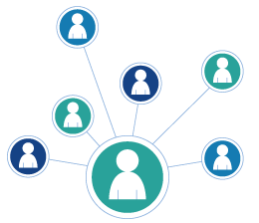

GENERAL STRATEGIES
INCREASING ONLINE AND OFFLINE PRESENCE
REFERRALS AND REVIEWS
OFFER ADDED VAUE
Yulu is majorly a B2C type of service. Hence the following measures could attract a greater audience-
Being active on social media helps but is of no use if no one follows the company’s official handles. This could be overcome by marketing Yulu on billboards, newspapers in such a way that they advertise to provide exciting prizes through various contests like quizzes, etc on social media sites.
A very easy thing to do to increase revenue per customer is to give them something more than the offer.
Keeping monthly distance quotas and providing people with discounts once they complete them could be an effective way to get people to use the product more.
Customers could be encouraged to leave in their reviews after each ride and share their referrals to interested friends and family members. This way, the product could be distributed to targeted customers easily and in turn generate more revenue for the company.
Great customer reviews also build brand reputation.

Slide 22
MARKETING STRATEGIES
THE FIRST MARKETING STRATEGY WE HAVE IDEATED IS BASED ON THE EVENT MARKETING TECHNIQUE.
CYCLE FOR FUN!
A Yulu-Bajaj initiative
Marketing Message:
“Daily Routine Stinks? Come ride with the community and take the break you deserve.”

Slide 23
THE PLAN
Yulu in partnership with Bajaj will host a “Cycle for Fun” event. This half day weekend event will take
participants through various casual/nature trails in and around the city and will cover 10-15 kilometers.
It will require participants to BYOB (bring your own bicycles) and for those who don’t have one, we will provide our very own Yulu Move. The event will be conducted in 4 cities- Delhi NCR, Mumbai, Bangalore and Pune.
HOSTING
We will have a team of 10 members on the field who will guide and monitor all the participants.
Each Yulu Move is equipped with a GPS tracker. We will have a team at the offices monitoring every Yulu bicycle
on the field so that the possibility of theft is ruled out.
INCENTIVES
Yulu is backed by Bajaj and keeping their strategic partnership in mind, a Bajaj Chetak electric bike worth
1 Lakh will be given away to one lucky winner.
Yulu has also inked a partnership with Uber and thus we will be giving out 5 discount coupons for Uber rides too.
Winners will be selected through a lucky draw at the end of the cycling event.
PREREQUISITES TO ENTER THE LUCKY DRAW
Each lucky draw enroller must have the Yulu app installed on his/her smartphone and must send a referral
to at least 5 of their known contacts through any social media handle. A selfie with appropriate hashtags
must also be posted on Facebook during the event.

Slide 24
THE TIMELINE
EVENT DETAILS AND FINANCING
DESIGN + MARKETING TEAM MEET
ADVERTISING
EVENT
MEASURING SUCCESS
Computing the event details and plan of action along with a rough budget and modes of advertising.
Ideate the event and come up with an effective design for social media handles and newspapers.
Advertising it extensively through newspapers and social media handles.
Conducting the event smoothly on a suitable date.
Measuring the success of the event through various KPI’s.

Slide 25

COST ANALYSIS
For this marketing strategy, the cost going in will only be for advertisements and branding since other things such as ideation, etc do no require any money.
On average, 1 square cm costs 1500 INR and an advert of 15x10 will cost 2 lac
Newspaper Ad for 4 cities
= 2lac*4
= 8lac
Extra Costs for Ads
= 2lac
Total Costs
= 10 lacs
Any extra costs that go into advertising are covered under this

Slide 26
MEASURING SUCCESS
We have assessed the success of this strategy using 4 different KPIs
Sales revenue:
This KPI will measure the increase in annual sales by analysing the number of users generated due to the event marketing strategy.
The present revenue generated by Yulu bikes is $1.5m, and given our event is free and offers heavy incentives, we believe that due to decent participation, our revenue will increase by 15%, i.e. $1.75m.
Though the event doesn’t generate large profits in its first time, the focus is customer satisfaction and brand building which will pay off in the long run.
Cost per lead:
It’s important to not only view things through the lens of how much you’ve made but also the cost to get you there.
This KPI will give us an estimate of the amount of money we’re spending to acquire new customers and will be crucial in understanding the success of our event marketing strategy.
On average, paid cycling events receive a participation of 50-150 and since our event is free and offers heavy incentives, we expect a participation of 500-1000 people, out of which 80% are non-Yulu users, amongst which 50% will start using Yulu and therefore create 300 users per city, i.e. 1200 users in all.
The cost going into the event is 10 lakhs as mentioned in the previous slide and thus the CPL is INR 833.

Slide 27
3. Traffic-to-lead ratio:
Comparing the ratio of our event traffic to the number of new leads generated after the event can be particularly telling.
If this ratio is high, that means people enjoyed the event, connected with Yulu’s concept of sustainability and started using Yulu more often. However, if the ratio is low, that tells us that our very concept of event marketing is flawed and that we need to relook the concept.
Since our event traffic is 3000 in all 4 cities combined and we acquired 1200 new users, our traffic to lead ratio is 2.5.
4. Engagement and Conversion:
This KPI is a measure of how many views our social media posts have gotten and corresponding to that, how many people have actually registered. Again, this KPI will give us a measure of whether our event has struck the audience strongly and whether our incentives are good enough to pull the audience to participate.
On average, 60% of the population must’ve seen our post out of which 9% of people attended our event and thus, 5.4% of people who read our post attended the event.

Slide 28
NEAR A YULU? GET PINGED!
This strategy utilizes the CRM (Close Range marketing) strategy.
THE PLAN
Any Yulu app user nearby a Yulu station will get pinged with the following/equivalent messages-
“You’re near a Yulu station. Ride now to save melting ice caps!”
HOW WILL THIS WORK?
Yulu app requires location access in order to work. When a user is in proximity to one of the Yulu station,
an automated message will be sent to the persons smartphone which will intimate the user about the station.
For this strategy to work effectively, extensive software development will be required. Using this as a follow up
strategy from the last one, a lot of referrals are expected to have been sent and it is estimated that a sufficient
population will have the Yulu app installed on their smartphones.
Since this strategy requires app development, the cost going into it is minimal as this software will be developed
by Yulu IT employees.
GOAL:
When a user will be intimated by the app, he/she will use Yulu instead of waiting for cabs and rickshaws which will contribute to increasing revenue on a satisfactory scale.

Slide 29
THE TIMELINE
DEVELOPMENT OF SOFTWARE
IDEATING THE CRM STRATEGY
MEASURING SUCCESS
TESTING OF SOFTWARE
STRATEGY IN ACTION
Ideating the actual strategy, laying out goals and formulating messages to display on users phones.
Developing the necessary software required for execution of the strategy.
Running mock rounds of the software and testing it out extensively for any errors and shortcomings.
Implementing the scenario in the real world environment while closely monitoring increase in user frequency.
Measuring the success of the event through various KPI’s.

Slide 30
TEAM BRANIAC
Tejas Bhale
Hrishikesh Patil

